Slide 1

College Student Management Report
An Analysis

Slide 2
Today’s Agenda
Project Recap
The Analytics Team
Process
Insights
Summary
Thank You!

Slide 3


Project Recap
In an ever-changing world where the concept of education encompasses such vital fields as academic performance and behavioural engagement metrics from Learning Management Systems (LMS), it becomes imperative to conduct analysis of the emerging data from such records side by side with defined risk labels to facilitate early intervention planning.

Slide 4
The analytics team
Uche Austin Atuma Data Analyst/Data Engineer

Slide 5
process
Effective Data collection and gathering
Datasets cleaning.
Efficient Data Modelling to create and establish functional relationships between tables.
Data visualization by creating visuals to provide relevant business insights.
Propagating more understanding of insights to client through story telling

Slide 6
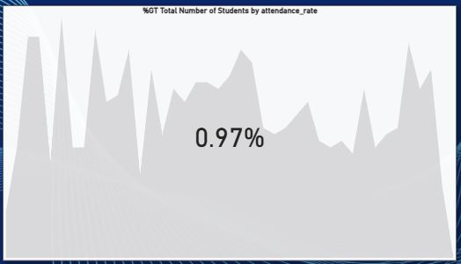

insight
Only 0.97% of students associated with the college have 100% attendance rate. Only 24.6% have an attendance rate of 90% and above.
A clear indication of the poor attitude to classes and academic activities.

Slide 7
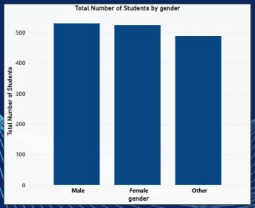

insight
From a total of 1545 students in the college, 531 (34.37%) are males, 525 (33.98%) females, and students with ‘other’ gender are 489 (31.65%).
Male and female genders, fairly equally represented.
‘Other’ genders not far behind in population figures.

Slide 8
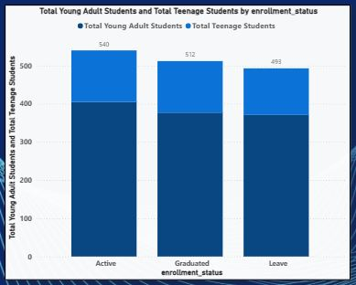

insight
Students defined in age brackets: Young Adults (20 – 25yrs) and Teenagers (18 – 19yrs). 74.63% are Young Adults while 25.37% are Teenage students. For enrolment status (Active, Graduated, Leave), the ratio of Young Adults to Teenagers is approximately 3:1.
Essentially, for every teenage student,
there are 3 young adult students
associated with college education

Slide 9
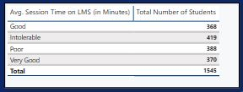
insight
A Learning Management System (LMS) is an application that helps to track and plan educational courses. To aid our analysis, the average time (minutes) students stay logged in on this application is ranked based on duration: Good (23.82%), Very Good (23.95%), Poor (25.11%) and Intolerable (27.12%).
Slightly more students do not spend appreciable time (in minutes) on the LMS, an indication of poor attitude to study.

Slide 10
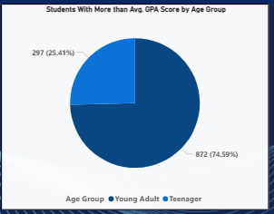
insight
Using an Average GPA Score > 2.50, an appreciable 75.66% of students met this criterion. Of this figure, 56.44% are Young Adults, while 19.22% are Teenage students.
24.34% students had a GPA score of <= 2.50
* Young Adult students, perhaps take their education a bit more seriously.

Slide 11
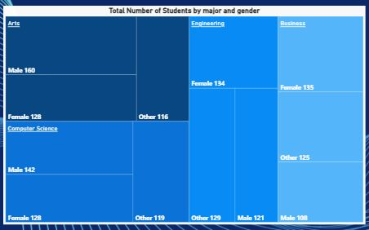
insight
The Arts and Computer Science disciplines have the highest number of college students – with more males than females and ‘other’ gender. 39.60% males in Arts, 36.50% males in Computer Science. Females dominate in Business and Engineering courses – 34.90% in Engineering and 36.68% in Business.
* The ‘other’ gender are non-dominant in any of the disciplines but are second in Engineering and Business courses.

Slide 12
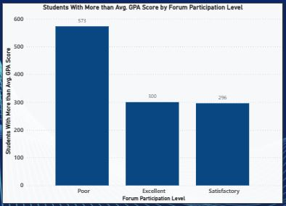

insight
For students with a GPA Score > 2.50, forum participation level analysis based on a grading system is vital. 49.01% had a poor forum participation level, 25.32% recorded a satisfactory level, and 25.66% were excellent in forum participation.
* About half of the students with GPA > 2.50 engaged more in self study.

Slide 13
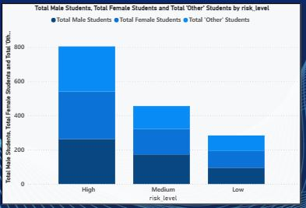
insight
The males, 34.37% face risks levels of varying degrees, females, 33.98% face varying degrees of risks, while ‘other’ gender, 31.65% face different degrees of risks.
52.10% are High Risks, 29.51% are Medium Risks and 18.38% are Low Risks. Females face more High Risks from analysis.

Slide 14
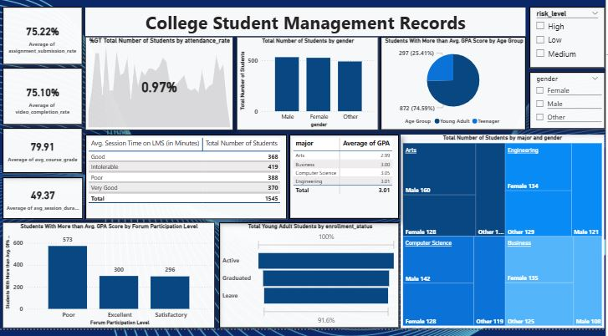
insight
Presentation of Report/Dashboard for quick glance of visuals and insights.

Slide 15
summary
ANALYSIS (A)
The attendance rate of students to classes is abysmal. Only 0.97% of students have a 100% attendance rate. And just 24.6% reach an attendance of 90% and above. This is a clear indication of poor attitude to classes and academic pursuit.
ACTION PLAN (A)
With the poor attendance rate observed, a seemingly drastic approach would be required to reverse this statistics and improve the situation. It may not be out of place to dedicate an appreciable percentage of the final examination scores for each course to the level of attendance. Students who reach 90%+ attendance automatically have 10marks added to their examination scores for each course.

Slide 16
summary
ANALYSIS (B)
The Learning Management System (LMS) is an application that helps to track and plan educational courses. The average time (in minutes) students stay logged in on this application is ranked based on duration: Good (23.82%), Very Good (23.95%), Poor (25.11%) and Intolerable (27.12%). This is another clear indication of poor attitude to academic dedication. This insights clearly show that more than half the student population have an engagement level on this application that is far from commendable.
ACTION PLAN (B)
One strategy would be to ascertain the availability and efficiency of this App. And that students have access to appropriate network connection environment. When all these factors are in place and the students’ poor engagements persists, it would be imperative

Slide 17
summary
ACTION PLAN (B)
to compel students’ engagement by making some school/academic activities online such as regular assignments submissions, online information and event updates etc.
ANALYSIS (C)
Forum participation is a viable means of learning that encourages students to interact more with their peers and exchange vital academic information. It helps particularly academically less-endowed students to measure up with their peers. However, analysis shows that 49.01% students with GPA > 2.50, actually had

Slide 18
summary
ANALYSIS (C)
‘Poor’ Forum Participation level. An indication that virtually half the population of the students who scored GPA > 2.50 engaged more in self study.
ACTION PLAN (C)
While it is ideal to encourage forum participation amongst students, the results of our analysis indicates that, in this scenario, it may not be recommended. Perhaps, in this instance, forums may have been distractive, discouraging genuine academic concentration and discourse. Self study should be encouraged here. Academically less-active students must be encouraged to work harder and seek a face-to-face tutorial engagement with relevant academic staff when convenient.

